Slide 1

School Advisory Forum Orientation
Broward County Public Schools
District Advisory Council
Central Area Advisory Council
North Area Advisory Council
South Area Advisory Council
NEXT NORTH AREA MEETING:
THURSDAY, SEPTEMBER 17, 2026
6:15P.M. - 8:45 P.M.
MONARCH HIGH SCHOOL - MEDIA CENTER
5050 Wiles Road, Coconut Creek, FL 33073

Slide 2
Orientation
Outline
TOPIC 1 WELCOME Contact Information
A Forum to Improve Education
Who We Are: Advocates
TOPIC 2 INSIGHT Purpose
Role
Meetings
TOPIC 3 HOW DO I GET STARTED Guidelines
Bylaws
Sunshine Laws
Robert’s Rules of Order
TOPIC 4 COMPONENTS OF A MEETING Advertising
Agenda
Minutes
Motions
TOPIC 5 ELECTIONS Process
TOPIC 6 COMMUNICATION Looping

Slide 3
W
E
L
C
O
M
E
TOPIC 1 CONTACT INFORMATION
TOPIC 1 CONTACT INFORMATION
North Area Advisory Council:
Register for Updates and Information at our Website: https://northareaadvisorycouncil.ch2v.com/
For Questions, please e-mail us at: NorthAreaChair@gmail.com
Follow us on Facebook: North Area Advisory Council
Other Area Advisory Councils:
District Advisory Council: https://browarddistrictadvisory.ch2v.com/
Central Area Advisory Council: https://centralareaadvisorycouncil.ch2v.com/
South Area Advisory Council: https://southareaadvisory1.ch2v.com/
Other Advisory Committees can be found on the School District Website: https://www.browardschools.com/community/advisories-and-committees
TOPIC 1
TOPIC 2
TOPIC 3
TOPIC 4
TOPIC 5
TOPIC 6

Slide 4

BROWARD COUNTY SCHOOL BOARD
TOPIC 1 A FORUM TO IMPROVE EDUCATION
Ideas, Concerns & Feedback
Flow UP
from
School to
SAF to
Area Advisory
and potentially
onto
District Advisory
and the
School Board
Requests for Feedback
Flow DOWN
from the
School Board
and
District Advisory
to gauge
support or concern
for
important
issues.
DISTRICT ADVISORY COUNCIL
SOUTH AREA ADVISORY
CENTRAL AREA ADVISORY
NORTH AREA ADVISORY
SAF
SAF
SAF
SAF
SAF
SAF
SAF
SAF
SAF
SCHOOL
SCHOOL
SCHOOL
SCHOOL
SCHOOL
SCHOOL
SCHOOL
SCHOOL
SCHOOL
TOPIC 1
TOPIC 2
TOPIC 3
TOPIC 4
TOPIC 5
TOPIC 6
Notes:
This is the back and forth exchange between parents and the district.
Because of the diversity of the advisory groups we are able to look at issues through different lenses. (perspectives)

Slide 5
W
E
L
C
O
M
E
TOPIC 1 WHO WE ARE: ADVOCATES
We are part of a team that advocates for children, our schools and our school stakeholders
  Advisory has:
  Pushed for Single Sign-on instructions on websites
  Promoted “Here Comes the Bus” App
  Advocated for no Clear Backpacks
  Continuing to advocate for no homework over the Holidays and following policy on make-up work
  Reproductive and disease prevention curriculum
  Successfully advocated to reducing testing and classroom screen time.
  Advocated for equality for all students and schools in policies.
  Advocated for the parents that can’t get involved.
TOPIC 1
TOPIC 2
TOPIC 3
TOPIC 4
TOPIC 5
TOPIC 6

Slide 6
TOPIC 2 PURPOSE
I
N
S
I
G
H
T
Every school has a School Advisory Forum (SAF):
Membership is open and includes parents or guardians, students, employees, business partners, and community members of the school. Participation from all backgrounds is welcomed and encouraged.
Fosters and promotes communication between stakeholders, the school, and the Advisory Council.
Provides an opportunity for stakeholders to discuss and recommend actions on school issues.
Every school has a School Advisory Council (SAC):
Membership is voted on and includes parents, teachers, community members, school administrators, non-instruction support staff, and other stakeholders.
Meet regularly to establish priorities, set annual objectives, and monitor action steps for school improvement.
Responsible for studying the school’s academic record and developing an annual plan to improve education in vital areas such as student achievement, curriculum, safety and discipline.
TOPIC 1
TOPIC 2
TOPIC 3
TOPIC 4
TOPIC 5
TOPIC 6

Slide 7
TOPIC 2 THE ROLE OF A SAF CHAIR
I
N
S
I
G
H
T
As an elected SAF Chair we facilitate the group and do not claim to represent every parent or community member at our school; we simply provide a means by which the community can discuss concerns at your school that are not addressed by the School Advisory Council (SAC).
Be supportive of the school and assist with finding solutions to concerns being raised at the school level.
Do not shy away from bringing something to the attention of your principal or SAF members.
Help identify community resources to improve student achievement and school effectiveness.
Remember we work together and we are not always going to agree on issues.
SAFs or officers are prohibited from endorsing political candidates.
Never blindside your principal.
TOPIC 1
TOPIC 2
TOPIC 3
TOPIC 4
TOPIC 5
TOPIC 6

Slide 8
TOPIC 2 AREA ADVISORY COUNCIL MEETING
I
N
S
I
G
H
T
School Advisory Council’s meet the fourth or first week of the month.
Area Advisory Councils meet the third week of the month.
  SAF Chair or designee shall represent each school as voting member of the Area Advisory Council
  Area Advisory Councils provide a forum for School Advisory Forum Chairs to bring forward issues or concerns raised at their schools
  District staff presents topics on district policy and procedure and SAF Chairs bring information back to their schools
District Advisory Council meets the second week of the month.
  DAC’s membership is derived from various groups. DAC’s membership is identified in its by-laws. Each Area/Region has an identified number of seats. SAF chairs are elected to fill those seats through their Area’s/Region’s election process
  DAC fosters and promotes communication among School Advisory Forums, School Advisory Councils, Area Advisory Councils, the District Advisory Council, the Superintendent of Broward County Schools, and the Broward County School Board.
TOPIC 1
TOPIC 2
TOPIC 3
TOPIC 4
TOPIC 5
TOPIC 6

Slide 9
TOPIC 3 GUIDELINES, BY LAWS, SUNSHINE
LAW AND ROBERT’S RULES OF ORDER
HOW
TO
GET
STARTED
The School Advisory Forum shall use guidelines developed by the district, develop and adopt procedural bylaws, conduct meetings in accordance with the Florida Sunshine Laws, and conduct meetings according to Robert’s Rules of Order, Newly Revised. Policy 1.3 (11)
The district has provided an Ethics training course at:
Committee Training Program & Resource Page
TOPIC 1
TOPIC 2
TOPIC 3
TOPIC 4
TOPIC 5
TOPIC 6

Slide 10
TOPIC 3 GUIDELINES
HOW
TO
GET
STARTED
Meetings must be advertised prior to the meeting date/time
SAF membership decides the date/time of the meetings. Meetings should be held either the fourth or first week of the month
All meetings shall be conducted in the “Sunshine" (i.e., open to the public)
The majority of your membership should be parents
No full or part-time School Board employee may hold the position of chairperson in the school where they are employed. Substitute teachers employed by an outside agency may hold an officer position.
The SAF must follow School Board Policy 1.3
SAF shall not collect dues
SAF shall not be fundraisers
Each SAF Chair must attend or, send a representative to the Area Advisory Council meetings
TOPIC 1
TOPIC 2
TOPIC 3
TOPIC 4
TOPIC 5
TOPIC 6

Slide 11
TOPIC 3 BYLAWS
HOW
TO
GET
STARTED
Every school must have a set of Bylaws.
A template is available in the SAF Manual or at: School Advisory Forum (SAF)
Bylaws set the rules for the organization
  Objectives
  Officers
  Duties
  Meetings
  Voting
  Amendments
TOPIC 1
TOPIC 2
TOPIC 3
TOPIC 4
TOPIC 5
TOPIC 6

Slide 12
HOW
TO
GET
STARTED
TOPIC 3 WHAT DOES IT MEAN TO
FOLLOW “SUNSHINE LAW” ?
Governmental Proceedings at state and local levels are subject to the Sunshine Law, this includes Advisory Boards
Meetings must be open and accessible to the public
Public notice of meetings required
Official minutes must be recorded
(Note: Entire decision-making process must be conducted in an open manner)
TOPIC 1
TOPIC 2
TOPIC 3
TOPIC 4
TOPIC 5
TOPIC 6

Slide 13

HOW
TO
GET
STARTED
TOPIC 3 ROBERT’S RULES OF ORDER
Robert’s Rules of Order are guidelines on how to run a meeting, guide group talks, make choices and get things done fairly
The meeting structure according to Robert’s Rules of Order is dictated by an agenda
Robert’s Rules guides groups “One thing at a time” to move from topics and allow members to talk without talking over each other
TOPIC 1
TOPIC 2
TOPIC 3
TOPIC 4
TOPIC 5
TOPIC 6
Notes:
An agenda helps you stay on topic.

Slide 14
COMPONENTS
OF A
MEETING
TOPIC 4 ADVERTISING & AGENDAS
Step 1: Meetings must be advertised.
School Admin will assist the SAF Chair how to have their meetings advertised and who will upload information onto the SAC Upload Center.
Step 2: Meetings must have an agenda.
An agenda has three main purposes:
It clarifies your objectives in holding the meeting
It helps participants prepare for the meeting
It provides a guideline during the meeting
TOPIC 1
TOPIC 2
TOPIC 3
TOPIC 4
TOPIC 5
TOPIC 6

Slide 15
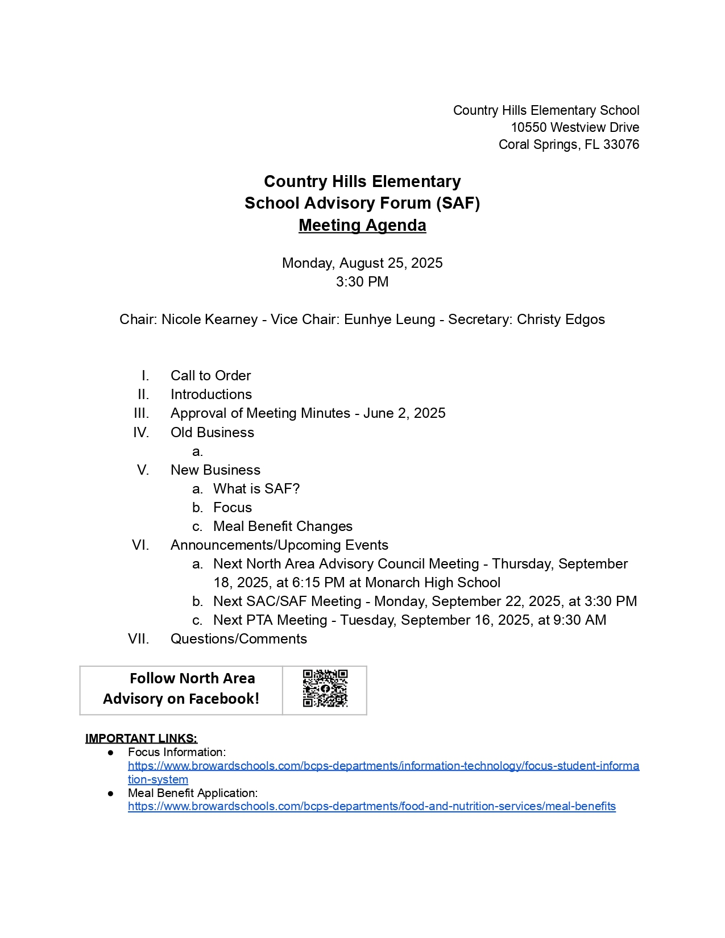
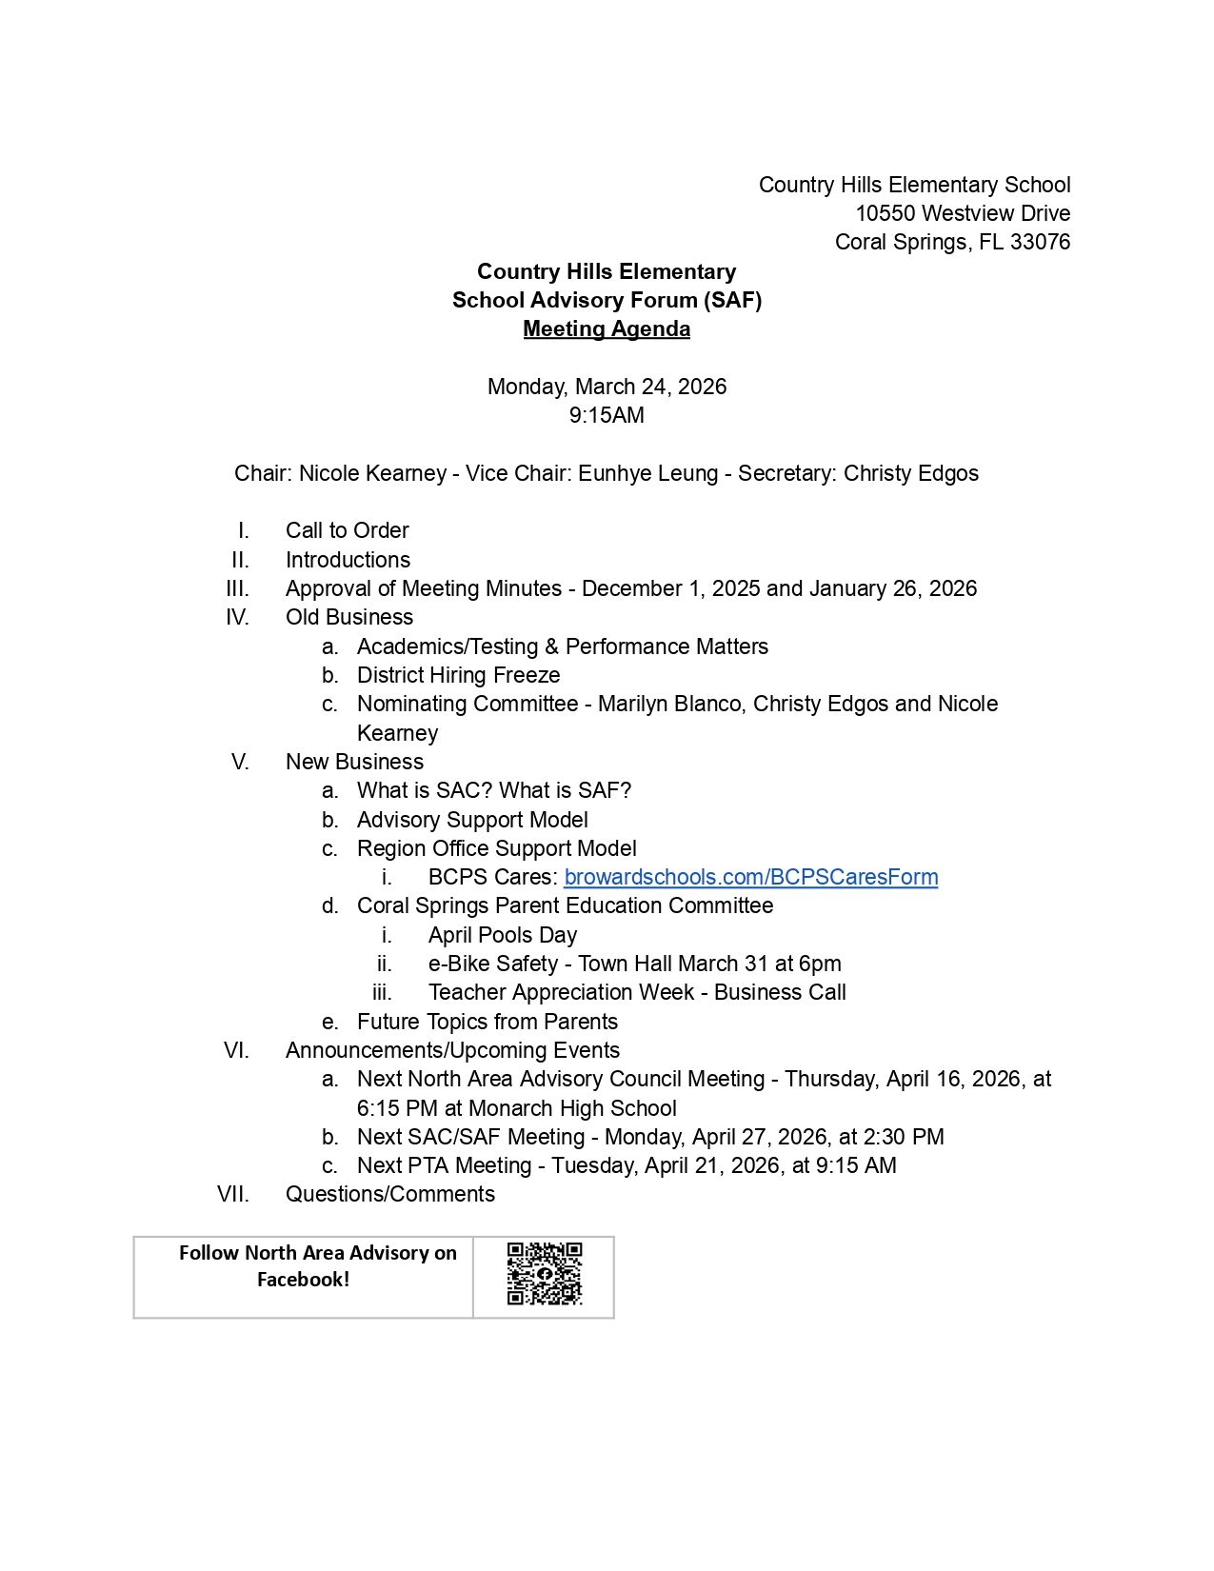
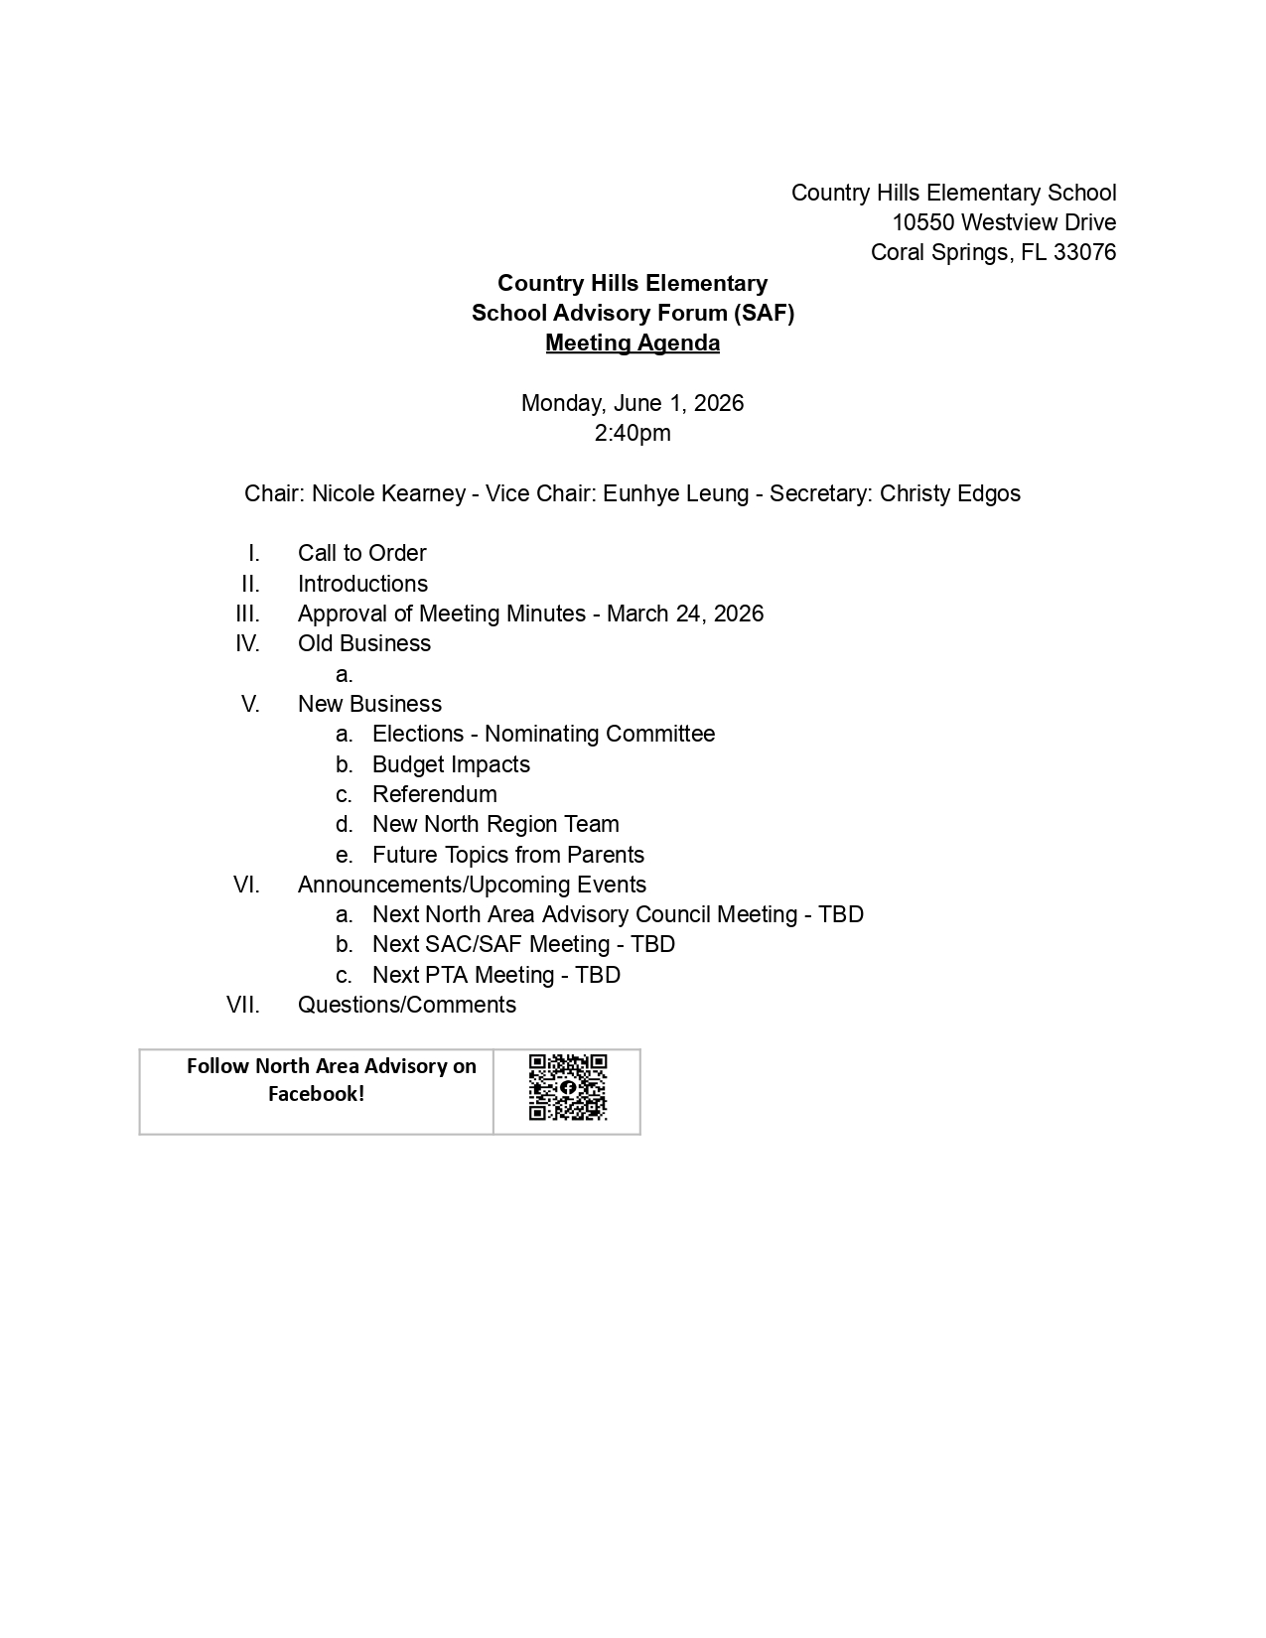
COMPONENTS
OF A
MEETING
TOPIC 4 SAMPLE AGENDA
TOPIC 1
TOPIC 2
TOPIC 3
TOPIC 4
TOPIC 5
TOPIC 6

Slide 16
TOPIC 4 MINUTES
COMPONENTS
OF A
MEETING
Step 3: Meetings must have minutes taken.
Record, maintain, and post minutes of all meetings at the school in accordance with the Florida Sunshine Laws and Policy 1.3 (12). Document major decisions (motions) and ensure that the participants agree with your understanding of the decision.
Minutes must be submitted to SAC chair to be uploaded.
Step 4: What is the purpose of making motions?
A motion is a formal proposal by a member to do something. Motions are the basis of the group decision-making process. They focus the group on what is being decided.
A motion is made at a meeting when a desired action is requested.
At a School Advisory Forum meeting a conversation or concern is often discussed and as a result of that discussion a motion is formed.
TOPIC 1
TOPIC 2
TOPIC 3
TOPIC 4
TOPIC 5
TOPIC 6

Slide 17
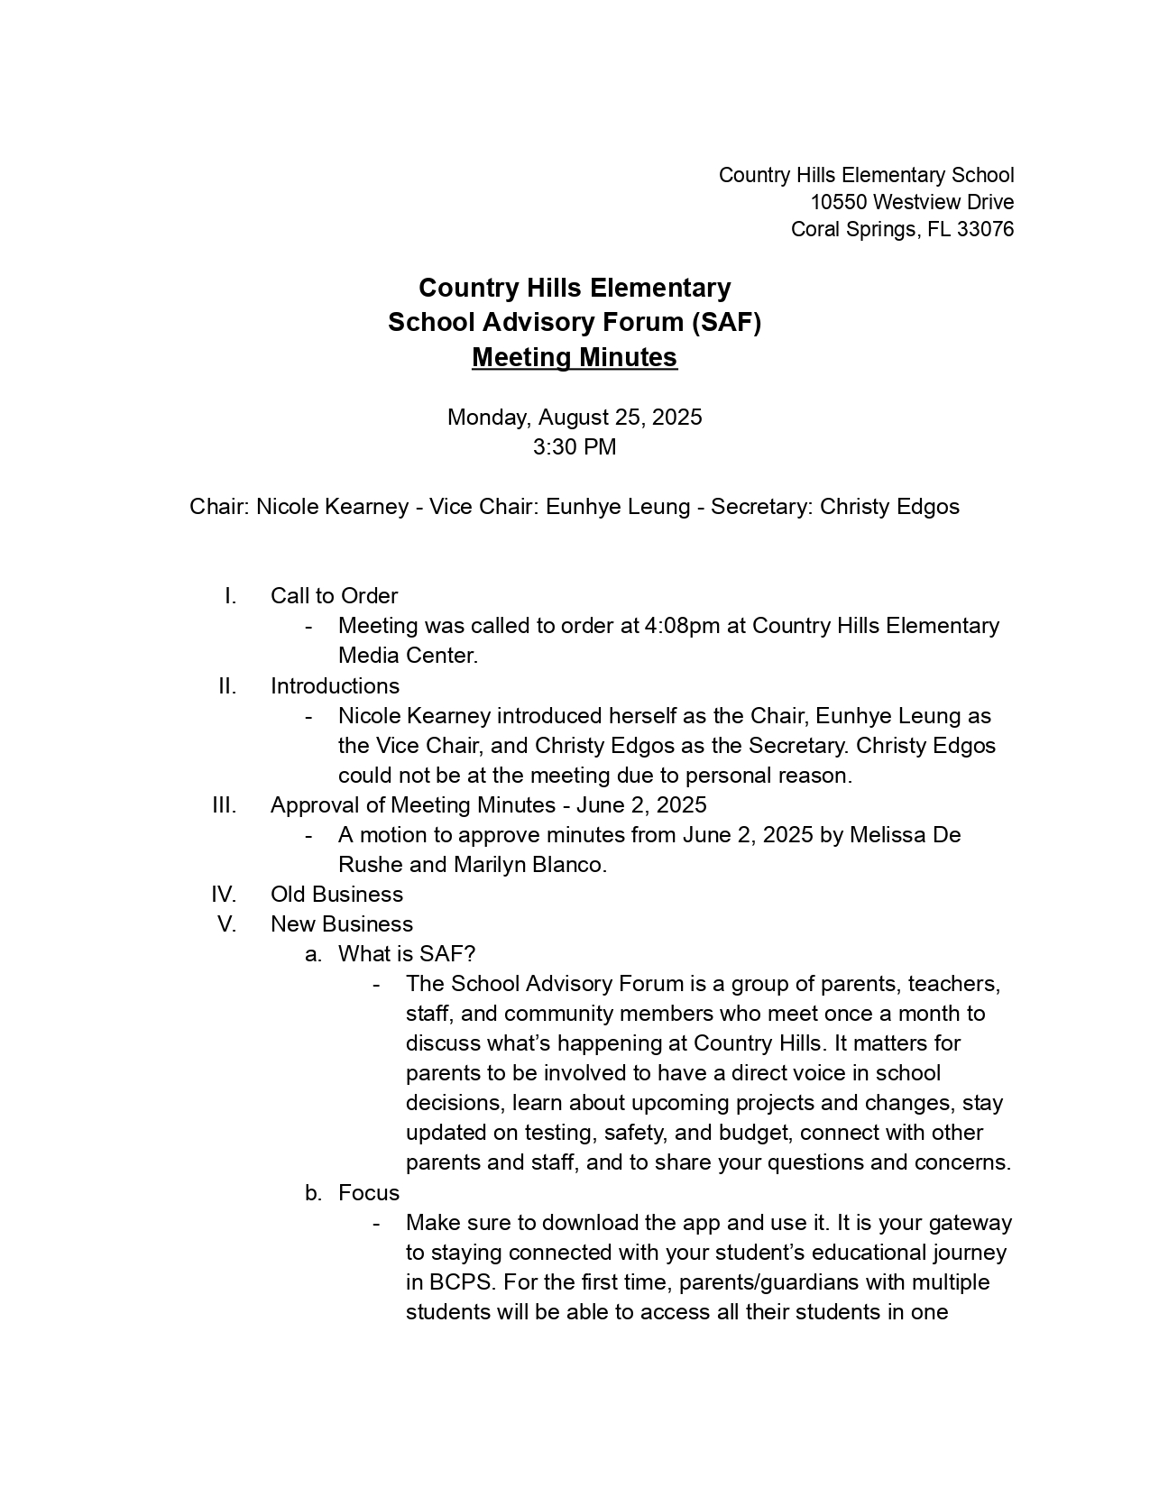
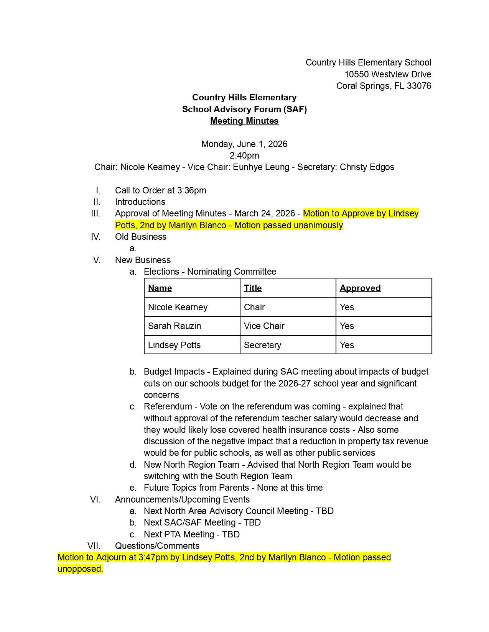
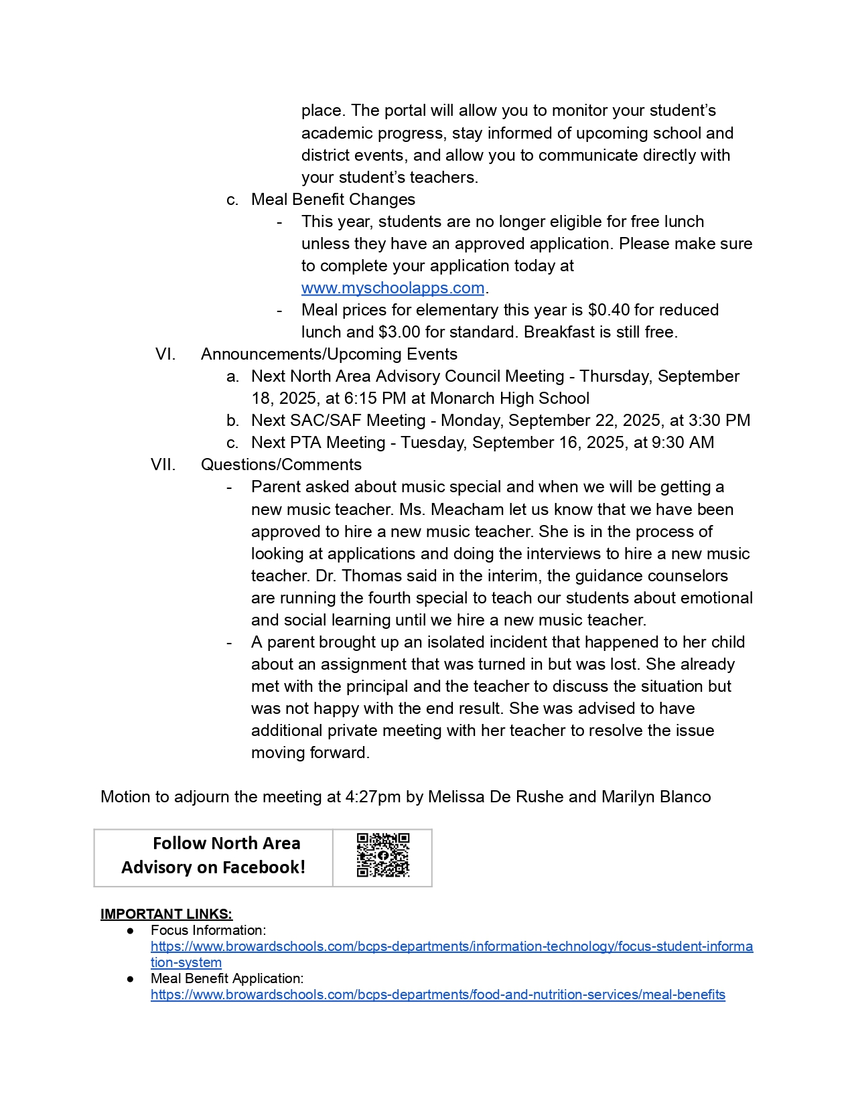
TOPIC 4 SAMPLE MINUTES
COMPONENTS
OF A
MEETING
TOPIC 1
TOPIC 2
TOPIC 3
TOPIC 4
TOPIC 5
TOPIC 6

Slide 18
TOPIC 4 MOTIONS
COMPONENTS
OF A
MEETING
The Chair recognizes the member wanting to make a motion.
  It is suggested that the presenter making the motion put it in writing first.
Making the Motion:
  Always state a motion affirmatively. Say, "I move that we ..." rather than, "I move that we do not ...".
  Another member will second the motion or the Chair will call for a second.
  When a second has been made the Chair will open the floor for discussion.
  An amendment can be made anytime while the motion is on the floor, the amendment must have a second to proceed. Amendments must be voted on first before voting on the main motion.
  If there is no second to the motion, it is lost. There is no further discussion.
TOPIC 1
TOPIC 2
TOPIC 3
TOPIC 4
TOPIC 5
TOPIC 6

Slide 19
COMPONENTS
OF A
MEETING
TOPIC 4 MOTIONS
Flow of a motion made at a
School Advisory Forum meeting:
  If it is an internal issue, then it goes to the Principal who addresses the motion with their staff or with District staff.
MOTION
MOTION
  If it is a global issue, then it goes to the Area/Regional Advisory Council. It may go to the Regional Superintendent or District Advisory Council.
TOPIC 1
TOPIC 2
TOPIC 3
TOPIC 4
TOPIC 5
TOPIC 6
Notes:
There are two ways to move a motion forward.
1. If it is an internal issue then it goes to the principal who addresses the motion with their staff or with District staff.
The second way is when
The School Advisory Forum Chair brings their motion to the Area Advisory Council General Meeting. (Email motion to Area Advisory Chair first, so that it can be placed on the agenda.)
If the Area Advisory Council approves the motion,
The Area Chairperson brings the motion to the District Advisory Council.
The Area Chairperson presents the motion to the District Advisory Council membership for consideration.
The motion becomes the ownership of DAC
The District Advisory Chair presents all motions, whether passed or failed to the School Board in the DAC Chair’s report to the Board.

Slide 20
TOPIC 5 ELECTIONS
ELECTION
PROCESS
FOR
SAF
PARENTS
Elections are held annually.
The Chair and Vice-chair shall be a parent or custodial guardian of a student who will be enrolled and attending the school during their term of service.
  The Chair cannot be a Broward County Public School employee* at the school where they are employed. (Refer to By Laws)
Elections must be advertised and should be held at a meeting where the most parents attend. (Example: Open house, School Advisory Forum or before a PTA/PTO, Band Booster meeting, SAC, NOT during the meeting.)
The Nominating Committee will present a slate to membership.
(Check your bylaws!)
*Denotes the requirement – that these individuals shall not be an employee of the School Board of Broward County, Florida, per the criteria of that position in accordance with applicable School Board Policy; except for a person whose employment is as a temporary substitute teacher.
TOPIC 5
TOPIC 1
TOPIC 2
TOPIC 3
TOPIC 4
TOPIC 6

Slide 21
TOPIC 6 THE PUBLIC ENGAGEMENT LOOP “LOOPING” – POLICY 1164
”Looping” has been designed for use only when a major initiative or new district wide program is under consideration
Information is presented at a District Advisory Council Meeting
The information is then presented to the Area Advisories SAF Chairs
The Area Advisory Chairs provide their feedback/motion to DAC
The SAF chairs return to their Area Advisory with their feedback/motion
SAF Chairs go back to their school and vet the information with their community
DAC brings forward a motion that is read at a School Board Meeting
The motion is catalogued by the Chief of Staff and forwarded to a department for a response
A response is provided within 21 days
TOPIC 5
TOPIC 6
TOPIC 1
TOPIC 2
TOPIC 3
TOPIC 4
Notes:
Example: 1. The Attendance Policy was presented to DAC with recommendations made by the Attendance Committee.
2. The policy revisions went to the areas and then the schools.
3. Recommendations from parents came back to the Area and then to DAC
4. A recommendation was made by DAC to have the parents have the ability to email the attendance clerk instead of having to call in.
5. The end goal was to have more parents notify their school of their child’s absence.

Slide 22

THANK YOU
We would like to take this opportunity to thank you for your dedication and commitment to the students of Broward County Public Schools.
YOU MAKE A DIFFERENCE!

